Slide 1
Reproducibility and Dynamic Documents
Roxanne Connelly
roxanne.connelly@york.ac.uk
@RoxanneConnelly
AQMEN DATA SCIENCE TRAINING AND CAPACITY BUILDING WORKSHOP
InTuition House, London
27th March 2019
Notes:
One and a half hours.

Slide 2
Problem

Slide 3
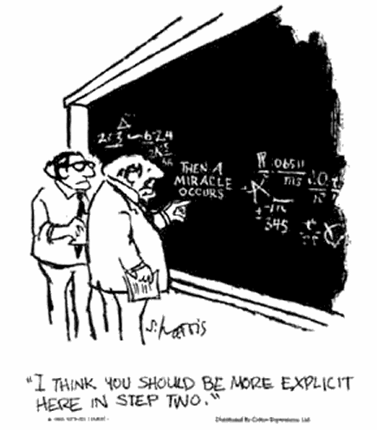

Slide 4


Slide 5


Slide 6

Notes:
Nullius in verba (Latin for "on the word of no one" or "take nobody's word for it")

Slide 7
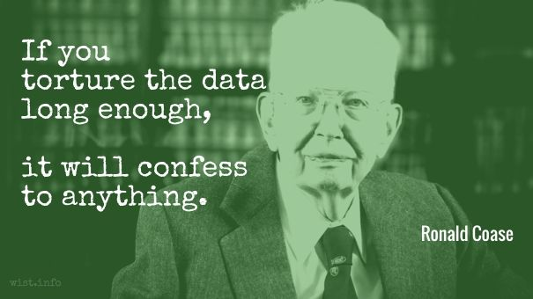
P Hacking

Slide 8
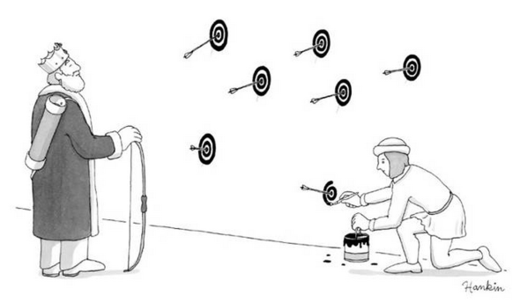
HARKing Hypothesizing After the Results are Known

Slide 9

Example: Screen Time

Slide 10
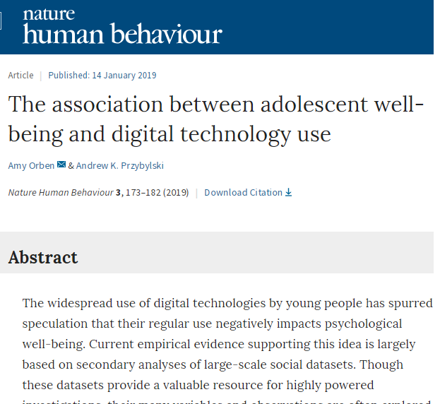
Notes:
New paper based on a massive sample (n=355,358) finds that screens explain less than 0.4% of depression.
Most analysts would agree that this effect is tiny – yet similar effect sizes using the same data are the basis for radical claims about the dangers of social media

Slide 11
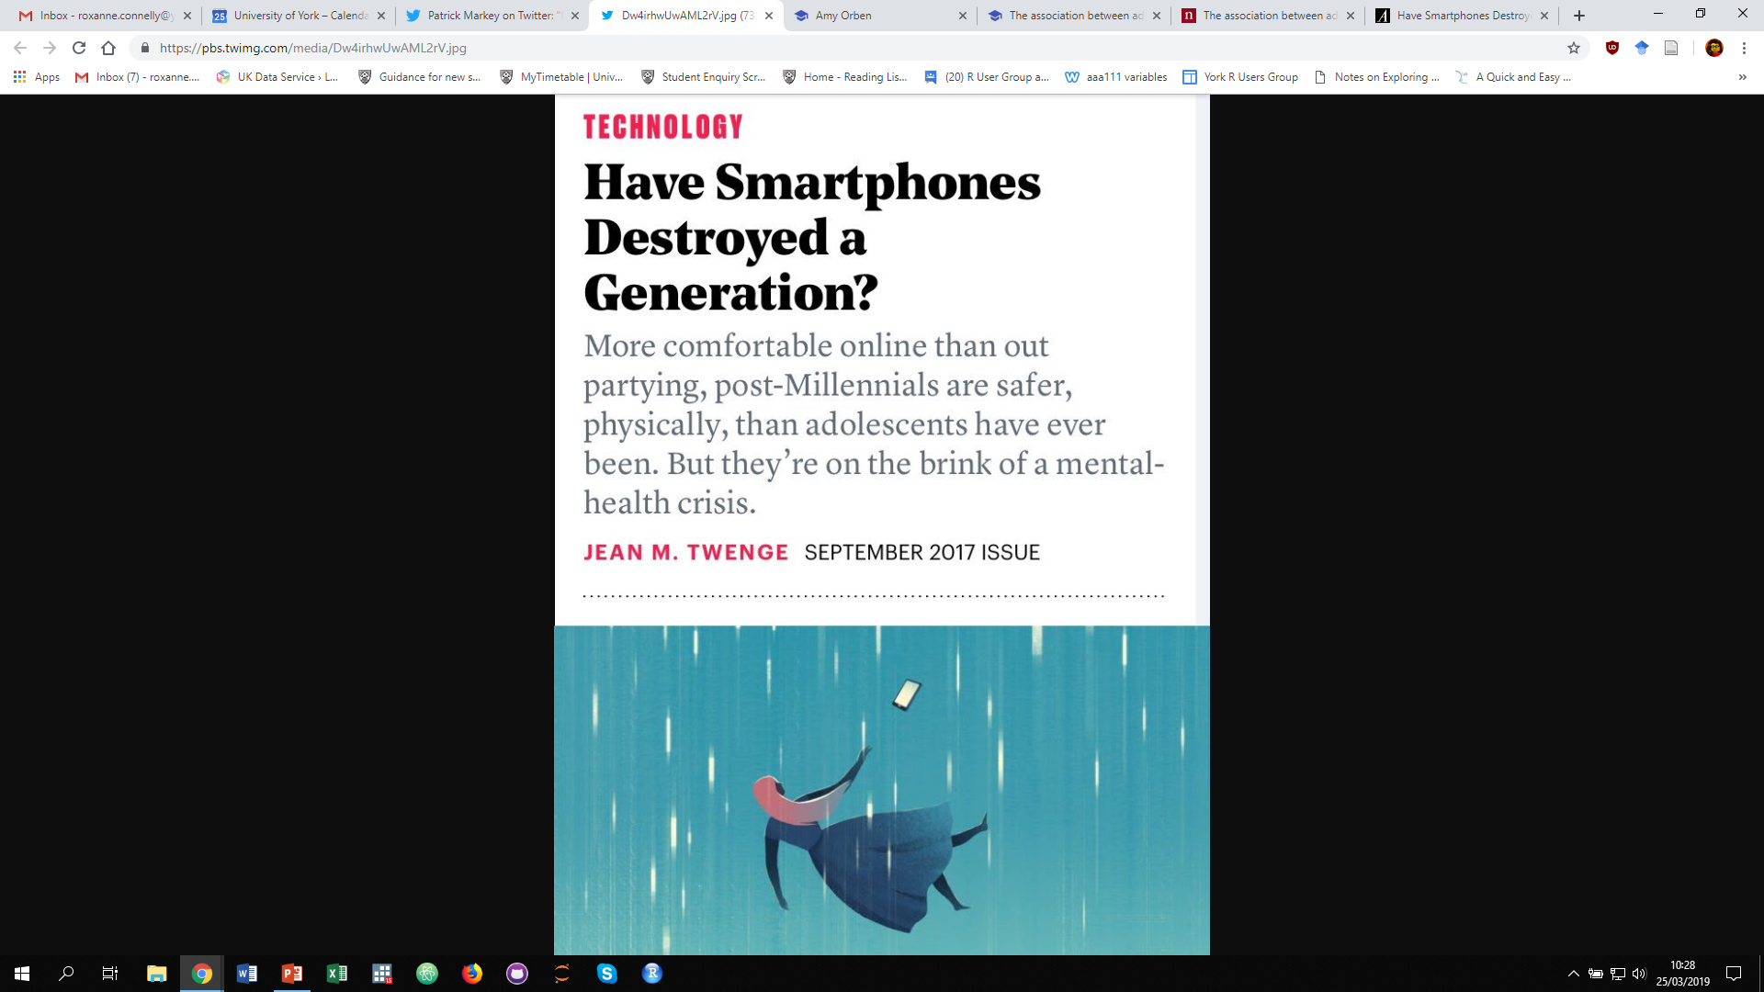
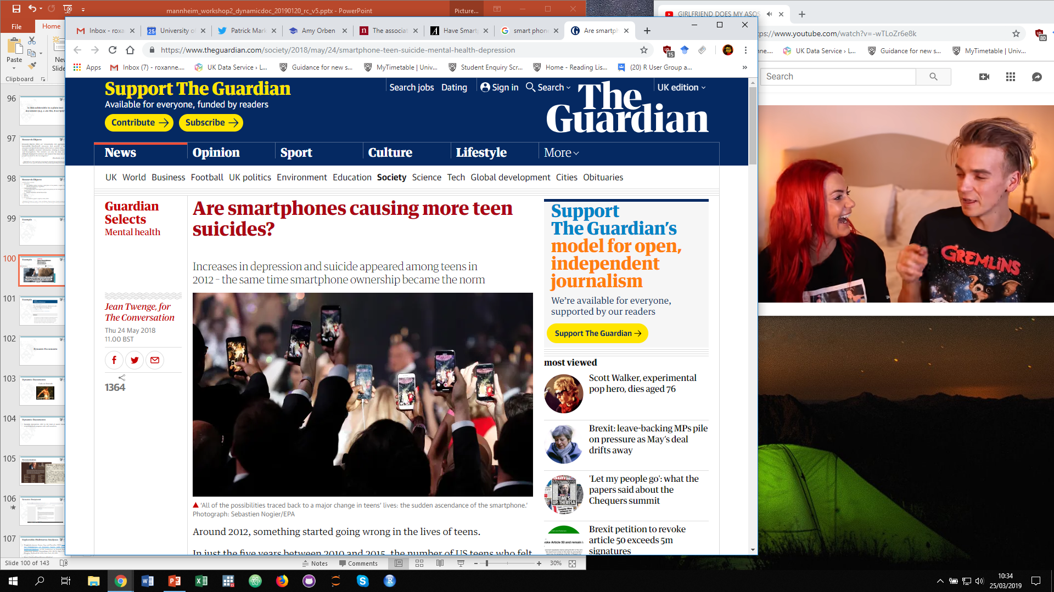
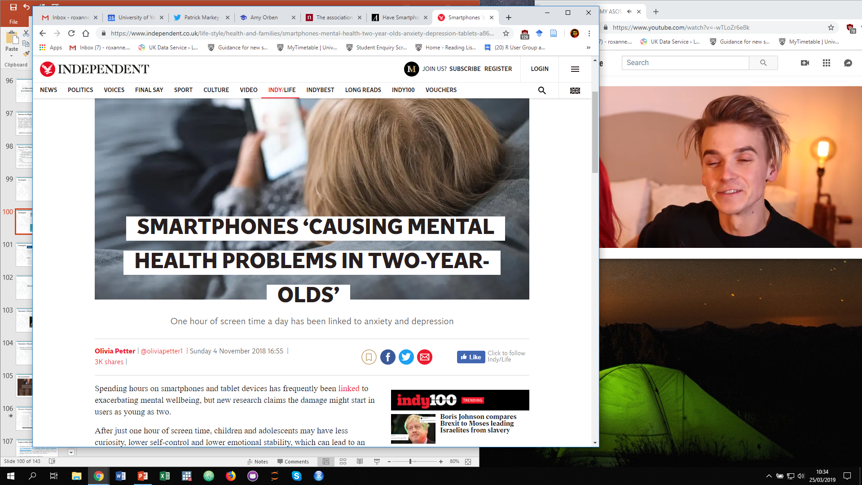
Notes:
New paper based on a massive sample (n=355,358) finds that screens explain less than 0.4% of depression.
Most analysts would agree that this effect is tiny – yet similar effect sizes using the same data are the basis for radical claims about the dangers of social media

Slide 12
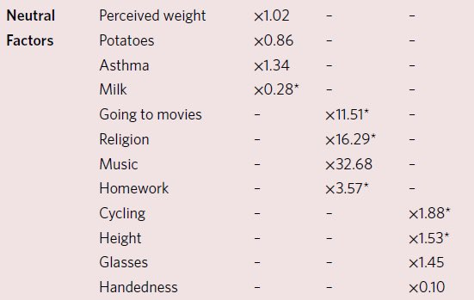
Notes:
But what the Nature paper did next is particularly interesting. It examines how strongly various neutral items in these data sets were related to depression. Below 1x means that the factor had the same effect as screen time. For example the effect of wearing glasses on depression is bigger than the effect of screen time, along with being left handed, bicycle use, and height.
So if we are to believe that screens are destroying a generation that would also mean that potatoes, not drinking milk, going to the cinema, music, religion, being tall, using a bicycle and wearing glasses are also destroying a generation.

Slide 13
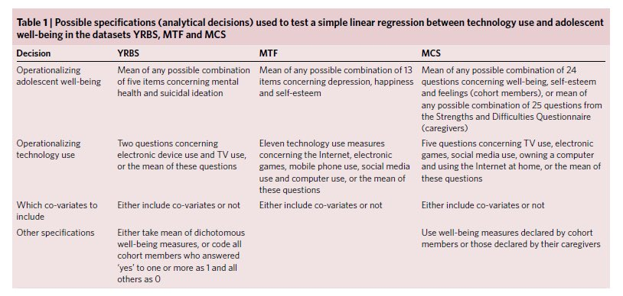
Notes:
Scientists wishing to make inferences about the effect of digital technologies using these data need to make numerous decisions about how to analyse, combine and interpret measures. Taking advantages of these valuable data sets is therefore fraught with many subjective analytical decisions which can lead to a high number of researcher degrees of freedom. With nearly all decisions taken after the data are known, these are not apparent to those reading the published paper highlighting only the final analytical pathway.
Previous researchers using these data sets made many “choices” before publishing their findings. For example there are various survey items that could be used in different combinations to measure depression.

Slide 14
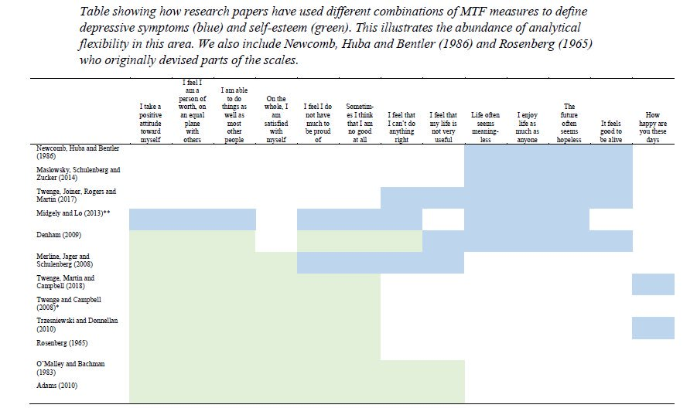
Notes:
In fact this is exactly what past scholars have done. Here is a breakdown of the different items past scholars have used to measure the same construct using the same data.
Various combinations of measures can produce very different results. This is problematic as it means researchers can basically make the data appear to tell whatever story they want it to tell.

Slide 15
Solutions

Slide 16
“It’s a kind of scientific integrity, a principle of scientific thought that corresponds to a kind of utter honesty - a kind of leaning over backwards. For example, if you’re doing an experiment, you should report everything that you think might make it invalid—not only what you think is right about it…”
(Feynman 1974)
Feynman, Richard P. "Cargo cult science." Engineering and Science 37, no. 7 (1974): 10-13.
Notes:
So I wish to you—I have no more time, so I have just one wish for you—the good luck to be somewhere where you are free to maintain the kind of integrity I have described, and where you do not feel forced by a need to maintain your position in the organization, or financial support, or so on, to lose your integrity. May you have that freedom.
We have to help early career researchers to do this stuff, and we have to reward them for it.

Slide 17


Slide 18
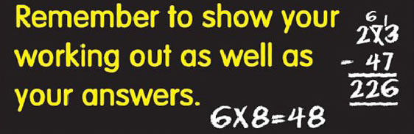

Slide 19



Slide 20
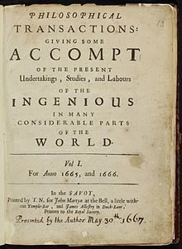
First Journal Publications
In 1665 the first peer reviewed journal articles were published (Journal des Sçavans and Philosophical Transactions of the Royal Society of London).

Slide 21


Modern Journal Publications

Slide 22
“The paper is just a palimpsest”
(Gayle 2016)
Notes:
Palimpsest: A parchment or other writing surface on which the original text has been effaced or partially erased, and then overwritten by another (OED).

Slide 23
Documentation
You should document the whole research process (including the data management):
‘Methods’ sections of publications do not allow sufficient detail to be presented.
We need to share details of the whole research process!

Slide 24
The TOP Guidelines
The TOP Guidelines were created by journal, funders and societies to align scientific ideals with practices.
Published in 2015, the Transparency and Openness Promotion Guidelines include eight modular standards, each with three levels of increasing stringency.
Over 5,000 journals and organizations have already become signatories of the TOP Guidelines.
https://cos.io/our-services/top-guidelines/
Notes:
Journals select which of the eight Transparency Standards they wish to implement and select a level of implementation for each. These features provide flexibility for adoption depending on disciplinary variation, but simultaneously establish community standards.

Slide 25
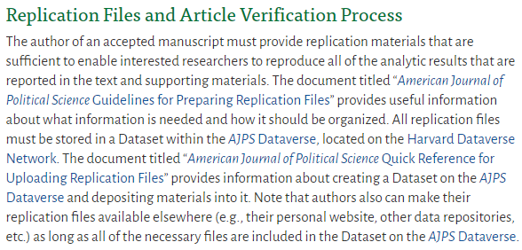
American Journal of Political Science
https://ajps.org/guidelines-for-accepted-articles/
Notes:
The author should prepare and upload replication materials before submitting the final draft of the accepted manuscript. The “American Journal of Political Science Data Verification Checklist” is designed to help authors ensure that they have provided all necessary files. When the final draft is submitted, the replication materials will be verified to confirm that they do, in fact, reproduce the analytic results reported in the article. The verification process is carried out by the Archive Staff at the Odum Institute for Research in Social Science, at the University of North Carolina, Chapel Hill. Immediately after successful verification, the Odum staff will release the Dataset for public access and the AJPS Editorial Staff will forward the final draft of the manuscript to the publisher for copyediting, production, and publication.

Slide 26
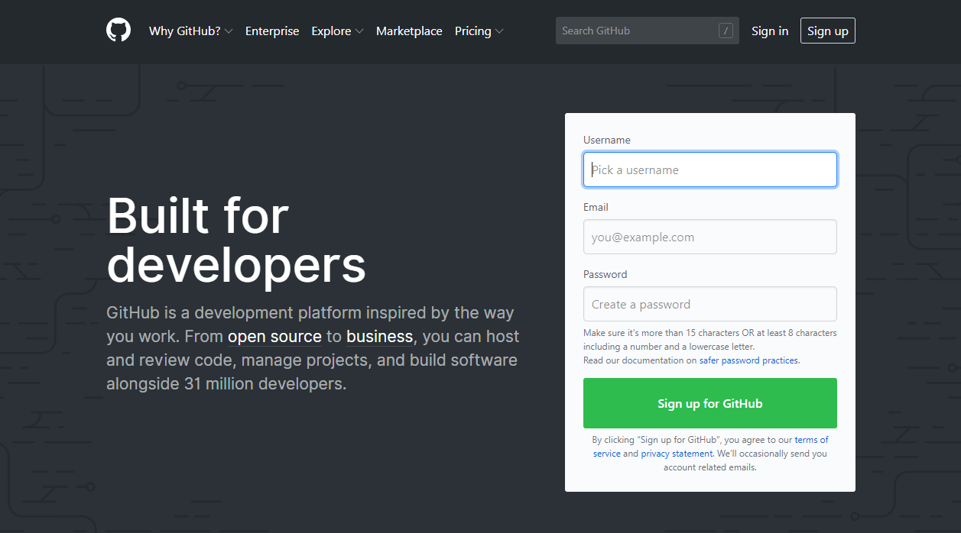
GitHub (github.com)
Notes:
GitHub is a web-based hosting service for version control using Git.
Git is a system for tracking chances in computer files and coordinating work on those files among multiple people. It is primarily used for source code management in software development.
git (which means unpleasant person in British English slang)
The name "git" was given by Linus Torvalds when he wrote the very first version. He described the tool as "the stupid content tracker" and the name as (depending on your way): - random three-letter combination that is pronounceable, and not actually used by any common UNIX command. The fact that it is a mispronunciation of "get" may or may not be relevant. - stupid. contemptible and despicable. simple. Take your pick from the dictionary of slang. - "global information tracker": you're in a good mood, and it actually works for you. Angels sing, and a light suddenly fills the room. - "goddamn idiotic truckload of sh*t": when it breaks

Slide 27
GitHub
GitHub is a web-based system to keep multiple revisions of your files and to share code easily with collaborators.
Notes:
The replication crisis continues to heat up discussion across social science. Hence principled researchers want to make their research easy to replicate and reputable journals are increasingly requiring replication files. In addition most modern research involves multiple collaborators.
GitHub is a system to keep multiple revisions of your files, to share code easily with collaborators.
Git was designed primarily for computer scientists who required a way to keep track of complicated revision histories of programs which involved multiple collaborators. It was developed in 2005 by the inventor of Linux – Linus Torvalds.
Since then, Git has become by the far the most important version control system, and GitHub the largest Git repository hosting service, has become by far the largest open-source collaboration site.

Slide 28
Version Control Software
Version control systems keep track of every change to a file over time so early versions can be restored.
Notes:
Git is version control software, which means it manages changes to a project without overwriting any part of that project. And it’s not going away anytime soon, particularly since Torvalds and his fellow kernel developers employ Git to help develop the core kernel for Linux.
Why use something like Git? Say you and a coworker are both updating pages on the same website. You make your changes, save them, and upload them back to the website. So far, so good. The problem comes when your coworker is working on the same page as you at the same time. One of you is about to have your work overwritten and erased.
A version control application like Git keeps that from happening. You and your coworker can each upload your revisions to the same page, and Git will save two copies. Later, you can merge your changes together without losing any work along the way. You can even revert to an earlier version at any time, because Git keeps a “snapshot” of every change ever made.
Version control software (VCS) has been used extensively in professional software engineering to manage changes to files (Cochez et al., 2013). In practice, these technologies enable multiple people to work together collaboratively whilst also permitting flexible change tracking, and the ability to revert to previous versions (Cochez et al., 2013; Sink, 2011). Centralised version control software retains the development repository on a central server, a popular example being Apache Subversion.⁴⁴ Distributed version control software enables users to keep a local copy of the repository which can be synchronized with a master repository (Muşlu et al., 2014).
The use of VCS has been recommended in computer science (Peng, 2011; Stodden and Miguez, 2014), behavioural science (Adolph et al., 2012) and cognitive neuroscience (Yarkoni et al., 2010). Gentzkow and Shapiro (2014) is a rare example of VCS being recommended in the social sciences. VCS is particularly well suited to text files rather than binary or data files (Ram, 2013). Therefore it is appropriate for the syntax files that are used in micro-level administrative social science data analyses. Git and Mercurial are examples of popular distributed VCS environments. To support sharing, online code repository hosting services such as GitHub⁴⁵ and BitBucket⁴⁶ are widely used.
A Git repository is a database containing all the information needed to retain and manage the revisions and history of a project.⁴⁷ There are a number of recognisable advantages in using a protocol like Git to share research code for micro-level administrative social science data research. First, the version control philosophy in computing science chimes with the idea of the workflow in social science data analysis. Second, the Git environment provides an audit trail. Third, the ability to ‘roll backwards’ to previous versions of code provides an efficient facility when developing analysis. Fourth, if shared on an open online code repository, code sharing is automated and this enhances both transparency and reproducibility and it enables others to update or maintain existing syntax files and removes the burden from the original author. Fifth, micro-attribution (i.e. crediting researchers for their contributions) is automated through the use of inbuilt tools.
We are not arguing that the use of VCS is a panacea. There is always a time-cost associated with learning to use a new piece of software and to learning to work within a new computing environment. The time commitment will generally be greater for social science researchers who are less computationally able. VCS packages have been designed for use by software engineers and are not immediately welcoming to social science users. We are encouraged by initiatives such as Software Carpentry⁵⁰ which provides workshops to help people without software engineering training to get the most out of the tools and techniques that are considered best practice for software development (see Wilson, 2006, 2014). It is reported that these activities have proven to be very successful in some scientific areas (Goble, 2014; Wilson et al., 2014). There are also numerous websites which have been created to assist researchers in understanding how to use distributed VCS. For example a proposal of good practice for working with Git is provided in Vincent Driessen’s post.⁵¹ An excellent introduction to the use of VCS in social sciences is posted by Andrew Hardie⁵² and by Carly Strasser from the California Digital Library.⁵³

Slide 29
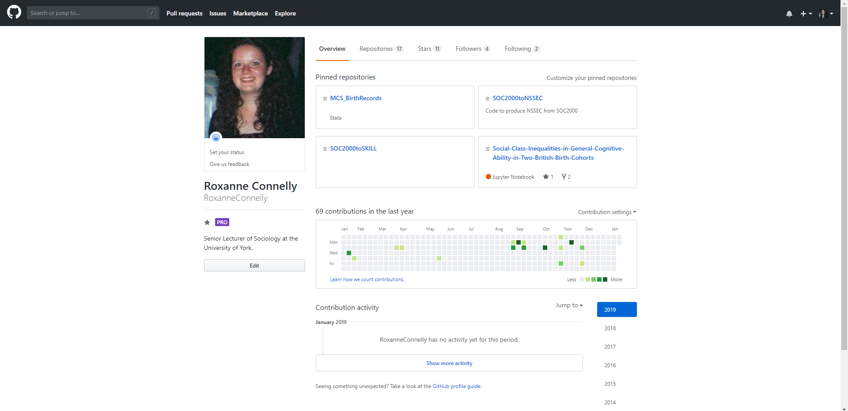
GitHub

Slide 30
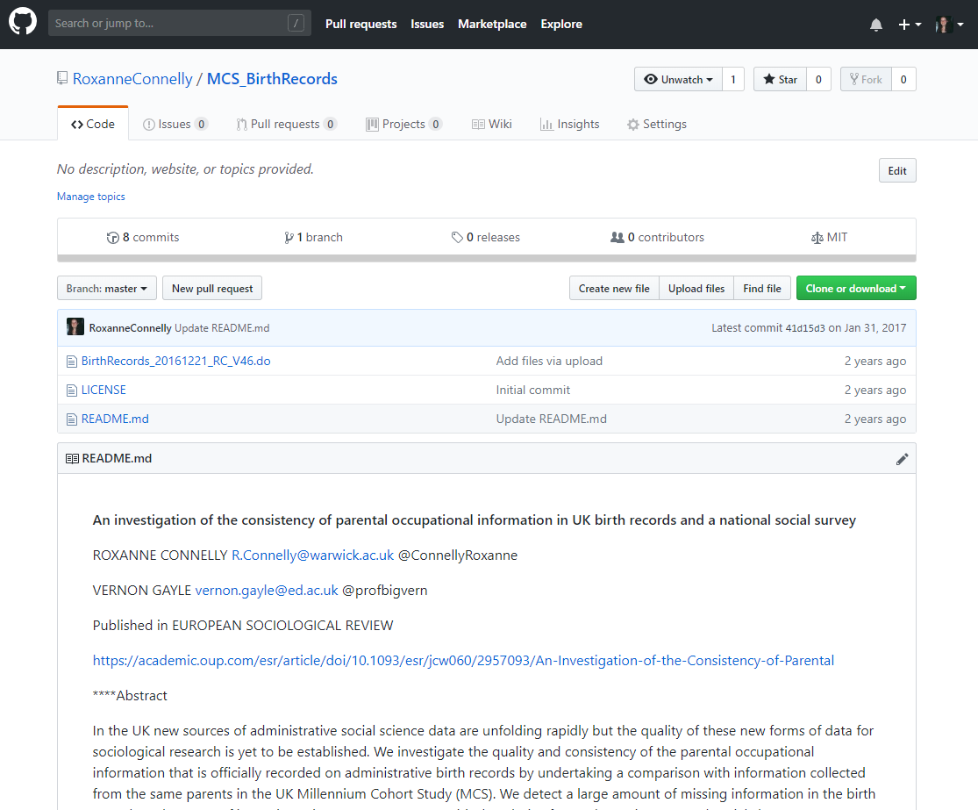
GitHub

Slide 31
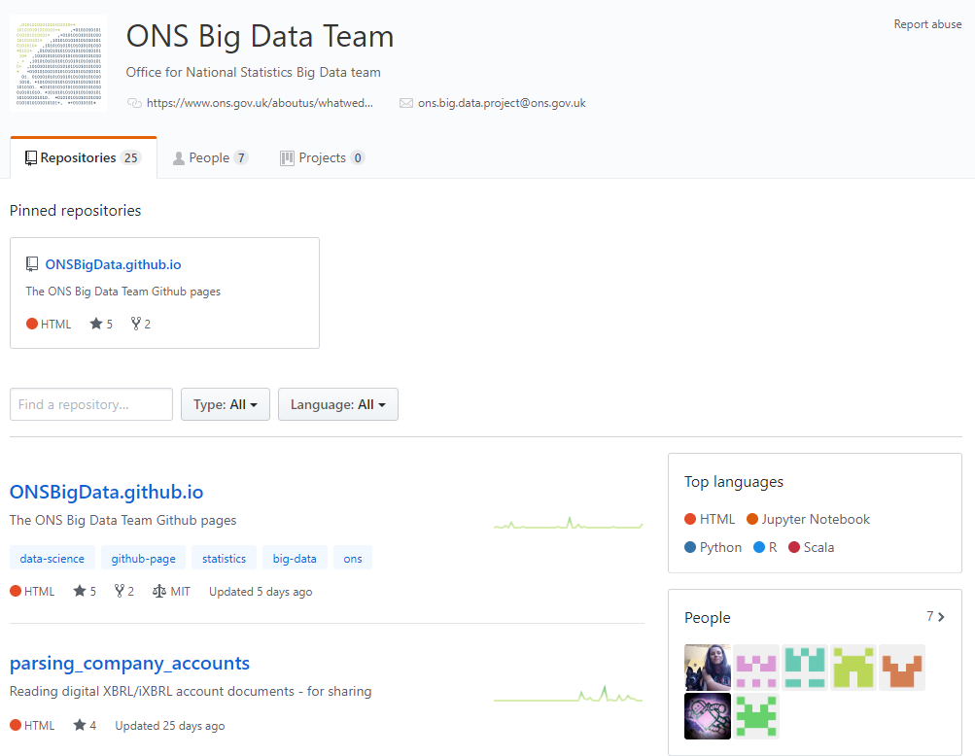
GitHub

Slide 32
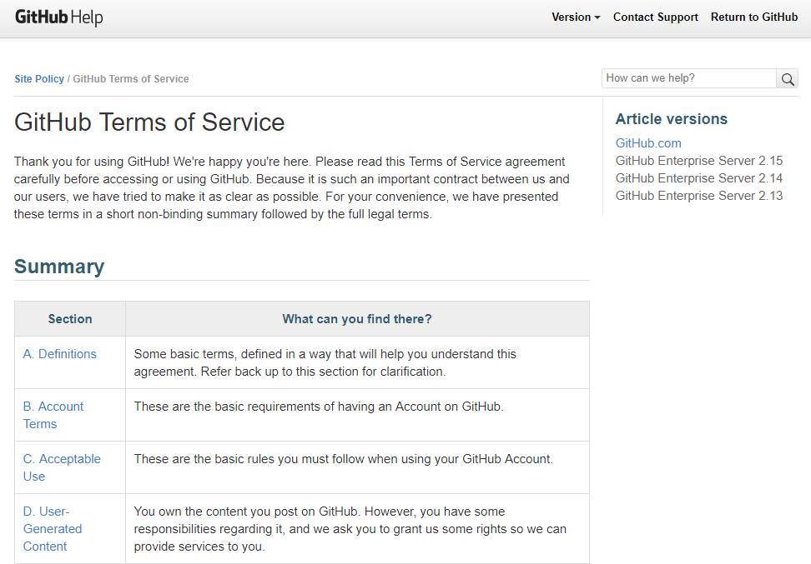
GitHub
“We claim no intellectual property rights over the material you provide to the Service. Your profile and materials uploaded remain yours.”
Notes:
If you check out Section F of the terms, you’ll see that GitHub does everything in its power to ensure that you retain total ownership of any projects you upload to the site:

Slide 33
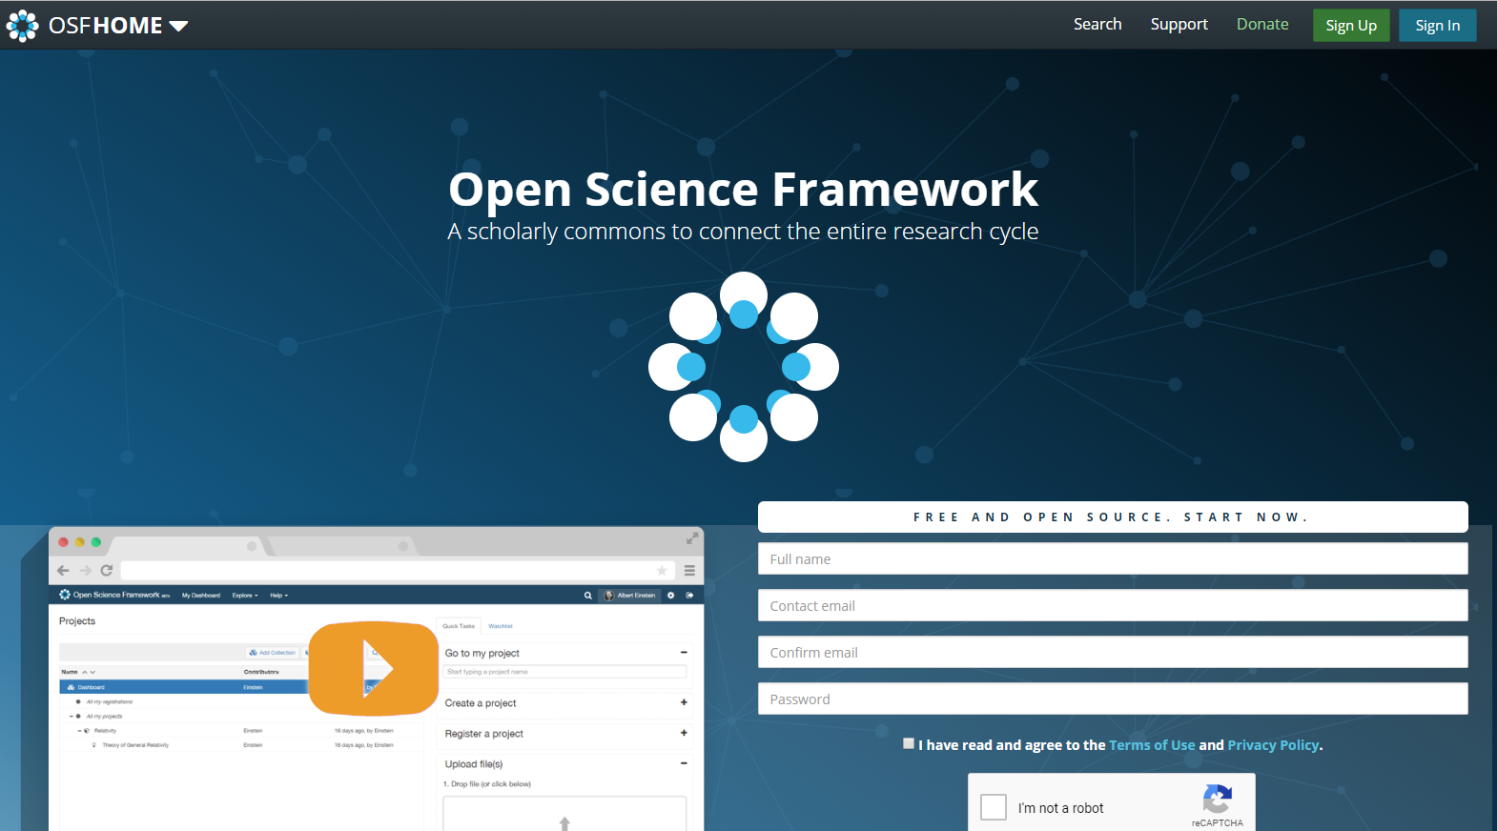
Open Science Framework (https://osf.io/)

Slide 34
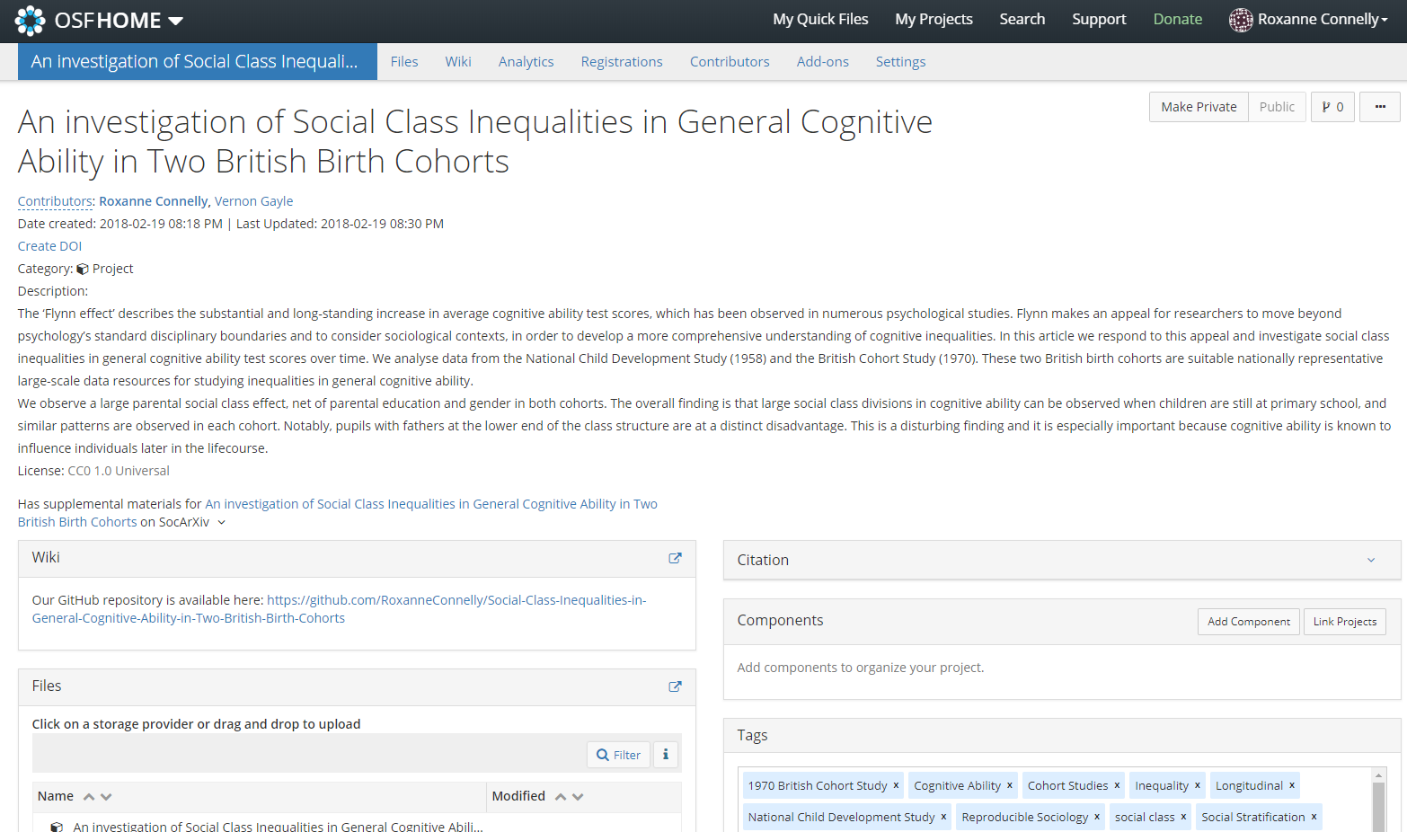
Open Science Framework (https://osf.io/)

Slide 35
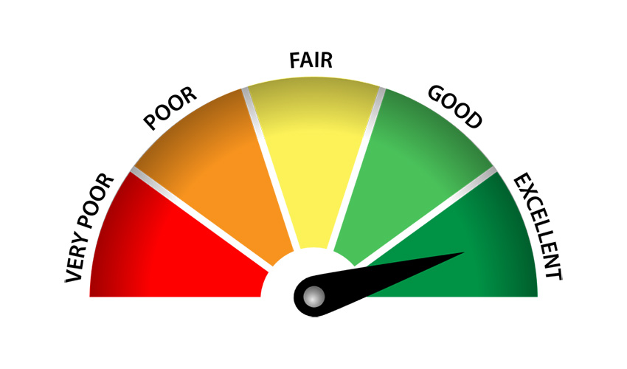

Slide 36


No Drop Down Menus
GUIs will leave you in a sticky mess!

Slide 37
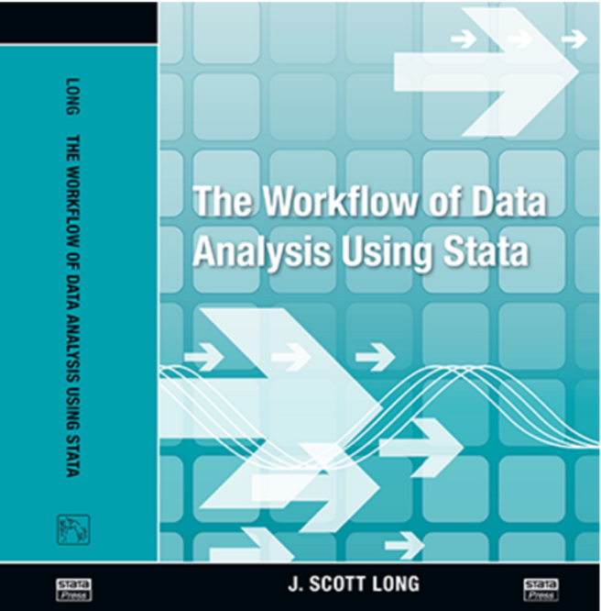
Long, J.S., 2009. The workflow of data analysis using Stata. College Station, TX: Stata Press.

Slide 38
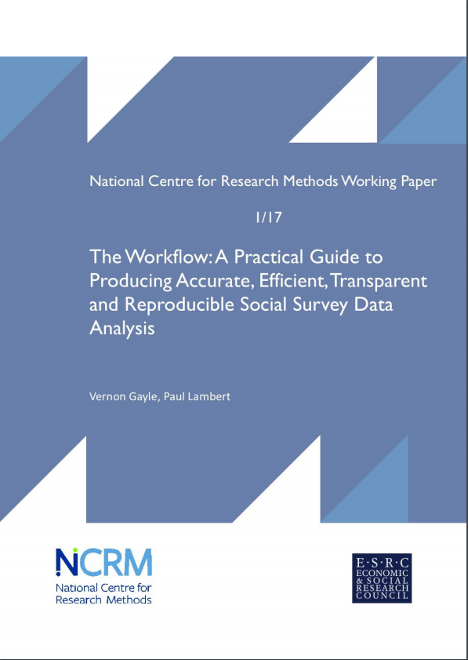
Gayle, V.J. and Lambert, P.S., 2017. The workflow: A practical guide to producing accurate, efficient, transparent and reproducible social survey data analysis. National Centre for Research Methods.

Slide 39
Effective Workflows
Accuracy
Efficiency
Standardization
Automation
Simplicity
Usability
Scalability
Notes:
Accuracy – if your program is not correct then nothing else matters.
Efficiency – completing the work quickly given accuracy and replicability. Tension between working quickly and working carefully.
Standardization – don’t repeatedly and inconsistently decide how to do things. Standardisation makes it easier to find mistakes.
Automation – automation procedures prevent mistakes and are faster. Never type anything you can obtain from a saved result.
Simplicity – the more complicated your procedures the more likely you will make mistakes or abandon your plan.
Usability – your workflow should reflect the way you like to work.
Scalability – different projects require different workflows.

Slide 40
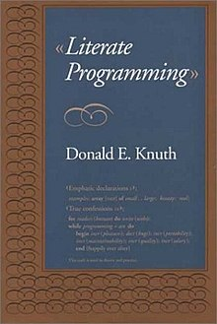

Literate Programming
Literate programming is a methodology that combines a programming language with a documentation language, thereby making programs more robust, more portable, more easily maintained.
The main idea is to treat a program as a piece of literature, addressed to human beings rather than to a computer.

Slide 41
Research Practice
Pair programming is an agile software development technique in which two programmers work together at one workstation. One, the driver, writes code while the other, the observer or navigator, reviews each line of code as it is typed in.
Code peer review is a software quality assurance activity in which one or several humans check a program mainly by viewing and reading parts of its source code, and they do so after implementation or as an interruption of implementation.

Slide 42
Is this achievable in a plain text document (e.g. a .do file, R script)?
Notes:
Successful research outcomes are far more likely if the analysis of large-scale social science data sets is guided by a planned workflow (Long, 2009). The workflow refers to a coordinated framework for conducting social science data analyses. The workflow includes planning, organising, executing and documenting analyses. The initial steps are likely to include bureaucratic activities such as applying for ethical approval, applying for access to the data, and gaining access to the data. This is likely to be followed by computational activities which begin with enabling data for analyses. The later steps are likely to include analysing data, presenting results, refining results, writing up and then publishing findings. The final steps will include archiving files of data and results, and then rendering them ‘reproducible’.
Recognised good practices in orchestrating a suitable workflow are as important in the analysis of administrative data as they are in the analysis of other large-scale social science data sets (e.g. social surveys). Long (2009) has provided an extensive, and almost rabbinical, account of good practices that we suggest analysts of micro-level administrative social science data should consult. In the passage below, we précis this work and make relevant connections with the emerging practice of administrative social science data analysis.
Central to the workflow is the concept of having an ‘audit trail’. The ‘audit trail’ is nothing more than a chronological account of the activities undertaken in the data analytical process. An alternative visualisation is that it is the breadcrumb trail of the research process. The audit trail is important because within the statistical analysis of social science data sets minor decisions have major consequences. Keeping track of even the most seemingly minor actions in the workflow is therefore important as it facilitates transparency, and makes contributions to efficiency and accuracy and ultimately to the overall success of the research project (this is also advocated by Sandve et al., 2013). Long (2009: 296) argues that the ‘the provenance of every result should be documented.’ Working towards this aim we believe that it is imperative for data analysts working with micro-level administrative social science data to create and record formal plans.

Slide 43
Research Objects
Research Objects (ROs) are ‘semantically rich aggregations of (potentially distributed) resources that provide a layer of structure on top of information delivered as Linked Data… An RO bundles together essential information relating to experiments and investigations. This includes not only the data used, and methods employed to produce and analyse that data, but also the people involved in the investigation.”
(Bechhofer et al. 2013)
S. Bechhofer et al., “Why linked data is not enough for scientists,” Future Generation Computer Systems, vol. 29, no. 2, pp. 599–611, Feb. 2013. http://dx.doi.org/10.1016/j.future.2011.08.004.
Notes:
Scientific data represents a significant portion of the linked open data cloud and scientists stand to benefit from the data fusion capability this will afford. Publishing linked data, however, does not ensure the required reusability. Publishing has requirements of provenance, quality, credit, attribution and methods to provide the reproducibility that enables validation of results.
Research objects respond to the notion of accessible reproducible research where scientific publications should provide clear enough descriptions of the protocols to enable successful repetition and extension. A reproducible results system that facilitates the enactment and publication of reproducible research. Such a system would provide the ability to track the provenance of data, analyses and results, and to package them for redistribution/publication. A key role of the publication is augmentation: convincing the reader that the conclusions presented do indeed follow from the evidence presented.
While traditional ‘paper’ publications can present intellectual argument, fostering reinforcement requires inclusion of data, methods and results in our publications, thus supporting reproducibility. A problem with traditional paper publications is “knowledge burying”. The results of an experiment are written up in a paper which is then published. Rather than explicitly including information in structured forms.
Current scientific knowledge management serves society poorly, where for example the time to get new knowledge into practice can be more than a decade.
The FAIR principles are a promising new development to operationalise the notion of open science. FAIR combines open access to data, software and other components of the research process by encompassing all “research objects” associated with a research project or paper. The idea of a “research object” or “scholarly research object” emerged from discussions of scholarly communication, research tools, and knowledge infrastructures to address eScience and other changes in the nature of scholarly communication.
As implemented in the FAIR principles, a research object can be either the entirety of the set of data and tools involves in an act of scientific discovery or a subset of a larger set of research objects. Reusability is a nebulous term, containing within it the concepts of reproducibility and replicability.
If not traditional papers and volumes, what, then should researchers be publishing? Whilst the digital exchange of data is straightforward, the digital exchange and transfer of scientific knowledge in collaborative environments has proven to be a non-trivial task, requiring tacit and rapidly changing expert knowledge – much of which is lost in traditional methods of publication and information exchange. There is a need for mechanisms that support the production of self-contained units of knowledge and that facilitate the publication, sharing and reuse of such entities.
S. Bechhofer et al., “Why linked data is not enough for scientists,” Future Generation Computer Systems, vol. 29, no. 2, pp. 599–611, Feb. 2013. http://dx.doi.org/10.1016/j.future.2011.08.004.
S. Bechhofer, D. De Roure, M. Gamble, C. Goble, and I. Buchan, “Research objects: Towards exchange and reuse of digital knowledge,” Nature Precedings, no. 713, Jul. 2010. http://dx.doi.org/10.1038/npre.2010.4626.1.
C. Goble, D. De Roure, and S. Bechhofer, “Accelerating scientists’ knowledge turns,” 2012. [Online]. Available: http://ora.ox.ac.uk/objects/uuid:17de32c4-518f-4be6-bf78- 1ecd6c761b81. [Accessed: 12-Mar-2012].

Slide 44
Dynamic Documents
Notes:
Rather than writing code aimed at telling the computer what to do, you write code that tells other humans what you are instructing the computer to do (and why). Now that you have the building blocks, you can tie them together to achieve truly literate code. There are several tools that provide ways of doing this.
Programming languages typically used by social scientists for data analysis have libraries or packages that can be used to generate reproducible reports. The most popular ones are Jupyter Notebooks for those who primarily use Python and Rmarkdown for those who use R.

Slide 45

Dynamic Documents
Code on Steroids
Notes:
On the one hand, based on literate programming (Knuth 1984), dynamic documents (Perez and Grander 2007) and compendiums (Gentleman and Lang 2007) constrain design choice to add human and machine readable context to executable code.
Dynamic documents are executable files that contain code with descriptive information. They are currently available with authoring packages in R (Knitr, Sweave) or Python (Ipython notebooks, Jupyter).
Compendiums aggregate dynamic documents.

Slide 46
Dynamic Documents
Dynamic documents refer to the kind of source documents containing both program code and narratives.
Notes:
On the one hand, based on literate programming (Knuth 1984), dynamic documents (Perez and Grander 2007) and compendiums (Gentleman and Lang 2007) constrain design choice to add human and machine readable context to executable code.
Dynamic documents are executable files that contain code with descriptive information. They are currently available with authoring packages in R (Knitr, Sweave) or Python (Ipython notebooks, Jupyter).
Compendiums aggregate dynamic documents.

Slide 47
Explorable Multiverse Analyses
Dragicevic, Jansen, Sarma, Kay, and Chevalier. 2019. Increasing the Transparency of Research Papers with Explorable Multiverse Analyses. In CHI Conference on Human Factors in Computing Systems Proceedings (CHI 2019), May 4–9, 2019, Glasgow, Scotland UK. ACM, New York, NY, USA.
https://explorablemultiverse.github.io/
Notes:
https://explorablemultiverse.github.io/
We present explorable multiverse analysis reports, a new approach to statistical reporting where readers of research papers can explore alternative analysis options by interacting with the paper itself. This approach draws from two recent ideas: i) multiverse analysis, a philosophy of statistical reporting where paper authors report the outcomes of many different statistical analyses in order to show how fragile or robust their findings are; and ii) explorable explanations, narratives that can be read as normal explanations but where the reader can also become active by dynamically changing some elements of the explanation. Based on five examples and a design space analysis, we show how combining those two ideas can complement existing reporting approaches and constitute a step towards more transparent research papers.

Slide 48
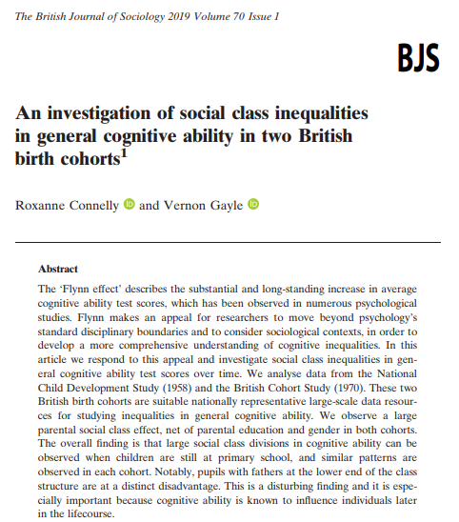
Connelly, R. and Gayle, V., 2019. An investigation of social class inequalities in general cognitive ability in two British birth cohorts. The British journal of sociology, 70(1), pp.90-108.

Slide 49
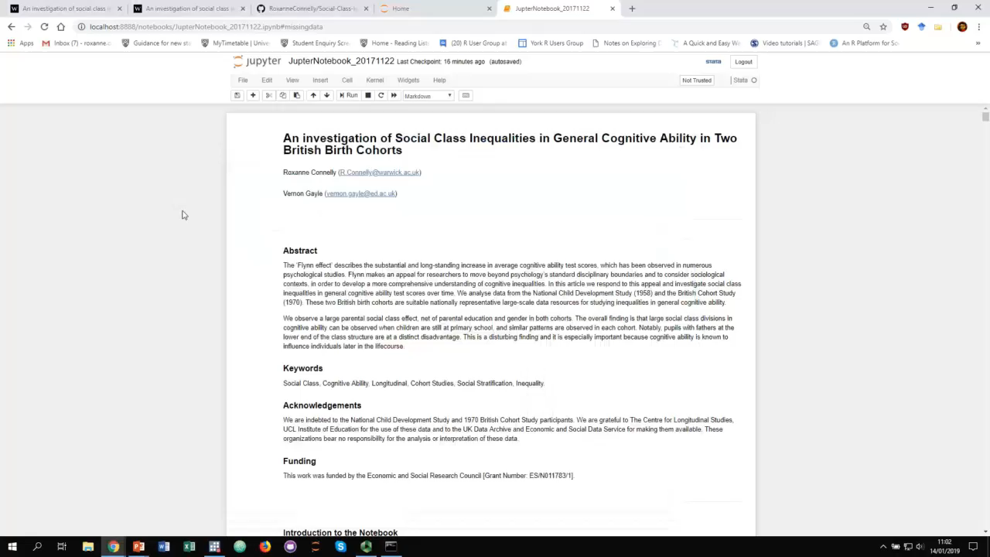
Notes:
An innovative aspect of this work is that we go beyond providing the usual supplementary material and make the complete workflow openly available. We take the trailblazing step of rendering the complete workflow accessible and reproducible within a Jupyter notebook5 (Kluyver et al. 2016). Jupyter notebooks are an open source web-based application that enable researchers to author documents that include live code6 (e.g., Stata or R code), alongside data analysis outputs (e.g., modelling results, plots etc.), and documentation (e.g., narrative text describing and detailing the workflow). Jupyter notebooks have been used in Nobel Prize winning high-profile big science applications7 but are rarely used in Sociology.
In developing an open and published workflow we have drawn upon ideas advanced in computer science especially the concept ‘literate computing’, which is the weaving of a narrative directly into live computation, interleaving text with code and results in order to construct a complete piece that achieves the goals of communicating results10 (Knuth 1992).

Slide 50
Making Dynamic Documents
Notes:
Rather than writing code aimed at telling the computer what to do, you write code that tells other humans what you are instructing the computer to do (and why). Now that you have the building blocks, you can tie them together to achieve truly literate code. There are several tools that provide ways of doing this.
Programming languages typically used by social scientists for data analysis have libraries or packages that can be used to generate reproducible reports. The most popular ones are Jupyter Notebooks for those who primarily use Python and Rmarkdown for those who use R.

Slide 51
Dynamic Documents
Software Specific Dynamic Documents:
Stata Dynamic Documents
R Markdown
Language Agnostic Dynamic Documents:
Jupyter Notebooks

Slide 52
R Markdown
R Markdown is described as an ‘authoring framework’:
You can connect to data and run code:
Generate reports of your work,
An R Markdown file is a simple plain text file with code, text and meta data.
The finished document will embed the code, narrative and results.
Notes:
R markdown provides an authoring framework. You can use a single R Markdown file to both:
Save and execute code
Generate high quality reports that can be shared with an audience.
R mardown builds html, pdf, word documents, as well as slides, notebooks, websites and interactive apps.
You can store and share your documents in a version control software like git, work collaboratively, and easily deploy again in the future.

Slide 53
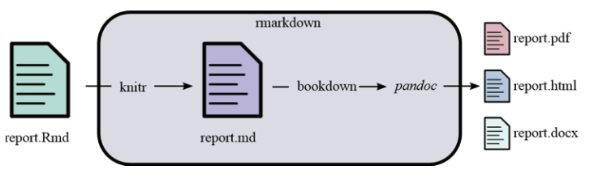
R Markdown
Source: https://www.britishecologicalsociety.org/wp-content/uploads/2017/12/guide-to-reproducible-code.pdf
Notes:
When you run render, R Markdown feeds the .rmd file into knitr which executes all of the code chunks and creates a new markdown (.md) document which includes the code and its output.
The markdown file generated by knitr is then processed by pandoc which is responsible for creating the finished format.
Rmarkdown is a file format (typically saved with the Rmd extension) that can contain text, code chunks and inline code. The markdown package converts this file into a report, most commonly into HTML or PDF.
The rmarkdown package automates a multi-step process. Under the hood, it calls the knitr package that converts the RmD file into a markdown (.md) file. In the process, knitr takes all the code chunks and the inline code, runs them through R, captures their output, and incorporates them in the report. Afterwards, rmarkdown calls the pandoc program (an external program that is not related to R) that can take the markdown file and converts it into a variety of formats.
The bookdown package helps with numbering the figures and tables, and dealing with citations. As its name suggests, this package can be used to author books, but is also well-suited to generating reports.
Knitr can execute code in many languages besides R. Some of the available language engines include:
Python, SQL, Bash, Rcpp, Stan, JavaScript, CSS.
You can use additional commands to format tables in the output.

Slide 54
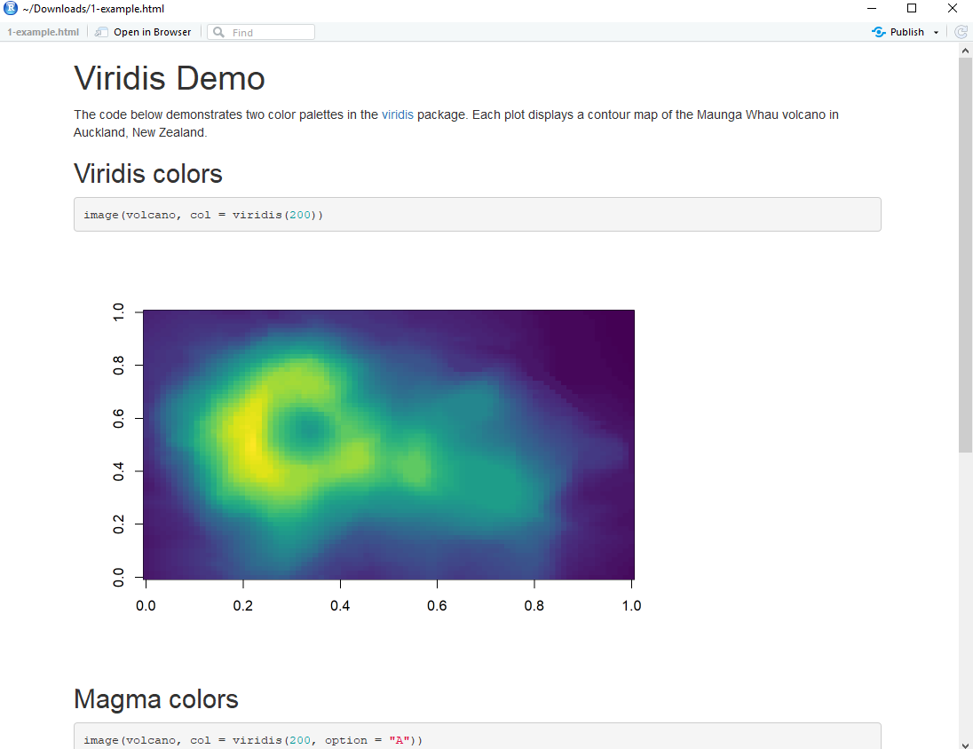
R Markdown
https://rmarkdown.rstudio.com/lesson-2.html
Notes:
You can then use the render or knit command to generate a new file that contains selected text, code and results from the R MarkDown file. The new file can be a finished webpage, PDF, MS Word, slide show, notebook.

Slide 55
Jupyter Notebooks
Notes:
Since 2011, the Jupyter Notebook has been our flagship project for creating reproducible computational narratives. The Jupyter Notebook enables users to create and share documents that combine live code with narrative text, mathematical equations, visualizations, interactive controls, and other rich output. It also provides building blocks for interactive computing with data: a file browser, terminals, and a text editor.
The Jupyter Notebook has become ubiquitous with the rapid growth of data science and machine learning and the rising popularity of open-source software in industry and academia:
Today there are millions of users of the Jupyter Notebook in many domains, from data science and machine learning to music and education. Our international community comes from almost every country on earth.¹
The Jupyter Notebook now supports over 100 programming languages, most of which have been developed by the community.
There are over 1.7 million public Jupyter notebooks hosted on GitHub. Authors are publishing Jupyter notebooks in conjunction with scientific research, academic journals, data journalism, educational courses, and books.
https://github.com/BuzzFeedNews
The Jupyter notebook is an open-source, browser-based tool functioning as a virtual lab notebook to support workflows, code, data and visualisations detailing the research process.
It is machine and human-readable, which facilitates interoperability (the ability of computer systems or software to exchange and make use of information) and scholarly communication.
These notebooks can live in online repositories and provide connections to research objects such as datasets, code, methods documents, workflows, and publications that reside elsewhere.
Jupyter notebooks are one means to make science more open.
Arguments for code and data sharing include reproducibility, reuse and transparency of research processes. However, sharing code and data alone is rarely sufficient to interpret findings that result from complex computational processes.
It is also necessary to access the software that generated data, research workflows, instrumentation details, laboratory notebooks and other documentation that constitutes the ‘recipe’ for how the research was accomplished. Jupyter notebooks are growing in popularity as a tool to integrate these resources and to provide access to them.
On behalf of the entire Project Jupyter team, we’d like to say congratulations to Rainer Weiss, Barry C. Barish, Kip S. Thorne and the rest of the LIGO and VIRGO teams for the Nobel Prize in Physics 2017. Since 2015, the LIGO and VIRGO Collaborations have observed multiple instances of gravitational waves due to colliding black holes (and more recently neutron stars). These observations represent decades of work and confirm what Einstein had theorized a hundred years ago.
To communicate to the broader community, the LIGO/VIRGO Collaboration has created tutorials with Jupyter Notebooks that describe how to use LIGO/VIRGO data and reproduce analyses related to their academic publications. Most notably, they published a tutorial for working with Binary Black Hole Data.
Binder allows any GitHub repository with Jupyter Notebooks to be turned into a live, runnable notebook instance that anyone in the world can access instantly. Today, LIGO makes interactive tutorials for each new gravitational wave event by posting links to Binder and Azure Notebooks so users can interact with the data and Jupyter Notebooks in an online environment. They are truly some of our best examples of Binder in action to date!

Slide 56
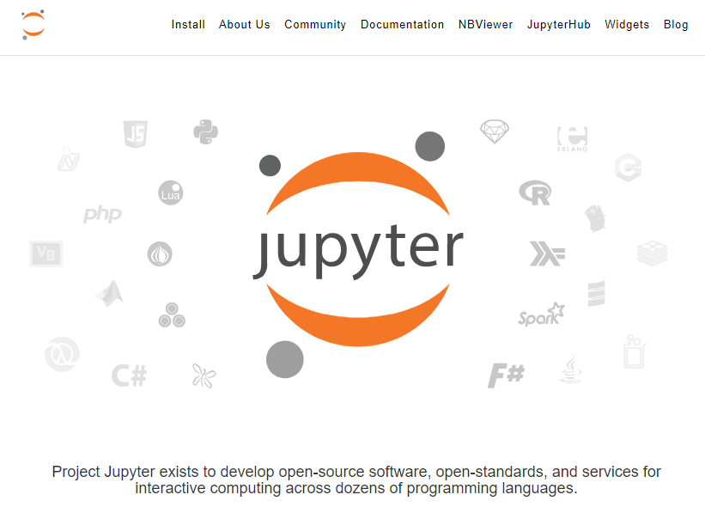
Jupyter Notebooks
https://jupyter.org/

Slide 57
The Ipython/Jupyter Notebook
Text and Maths
Code
Code Output
Results
Accessible through your web browser

Slide 58
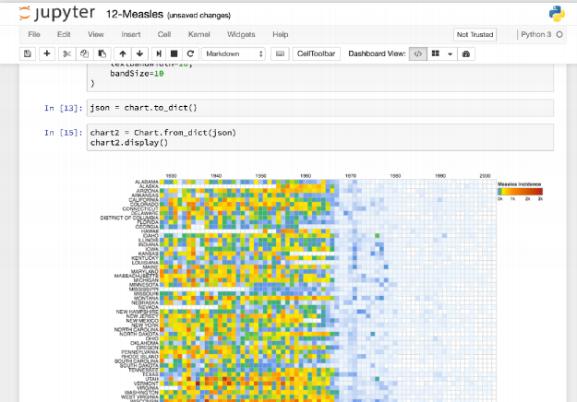
Jupyter Notebooks
https://hub.mybinder.org/user/jupyterlab-jupyterlab-demo-olagq5sj/lab

Slide 59
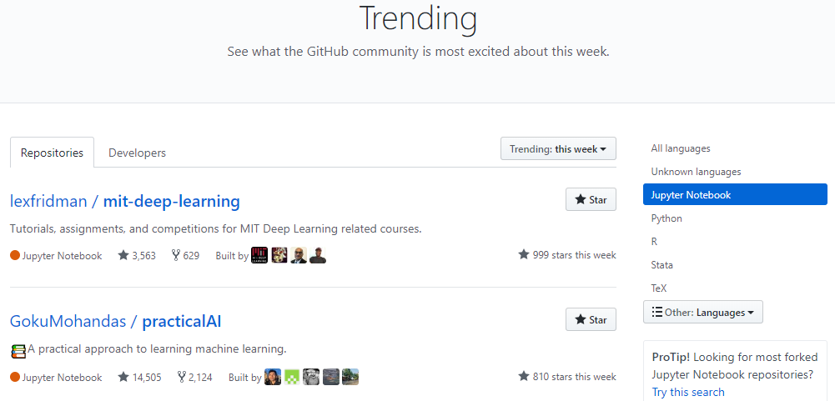
Jupyter Notebooks
https://github.com/trending/jupyter-notebook?since=weekly
Notes:
There are millions of users and millions of notebooks.

Slide 60
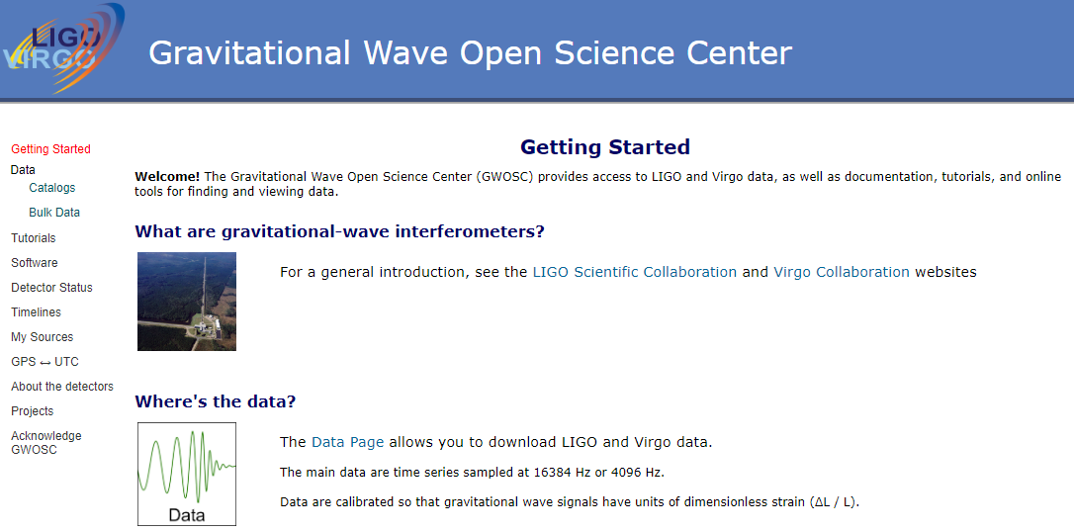
Jupyter Notebooks
https://www.gw-openscience.org/start/
Notes:
There are millions of users and millions of notebooks.
Interactive textbooks
Transparent journalism – buzzfeed

Slide 61
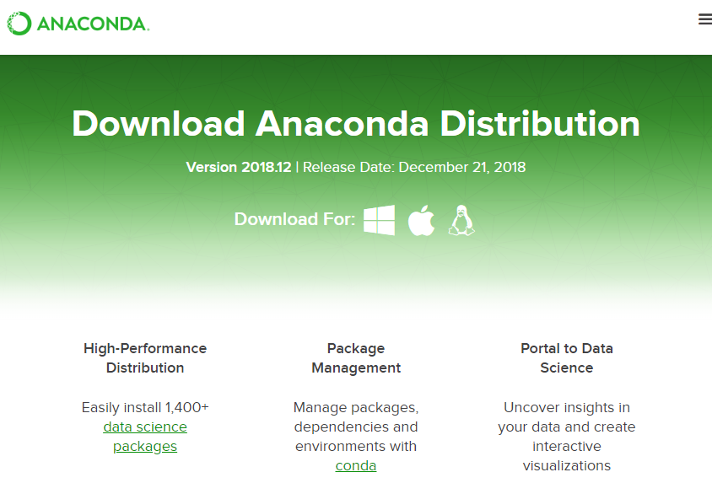
Download Jupyter Notebooks
https://www.anaconda.com/download/

Slide 62



Jupyter Kernels
R Kernel (IRKernel): https://github.com/IRkernel/IRkernel
Stata Kernel (stata_kernel) https://github.com/kylebarron/stata_kernel

Slide 63
Jupyter: Quick Demo

Slide 64
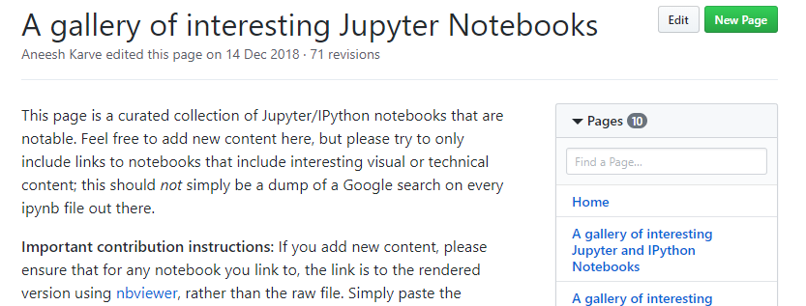
Jupyter Notebooks
https://github.com/jupyter/jupyter/wiki/A-gallery-of-interesting-Jupyter-Notebooks#introductory-tutorials

Slide 65
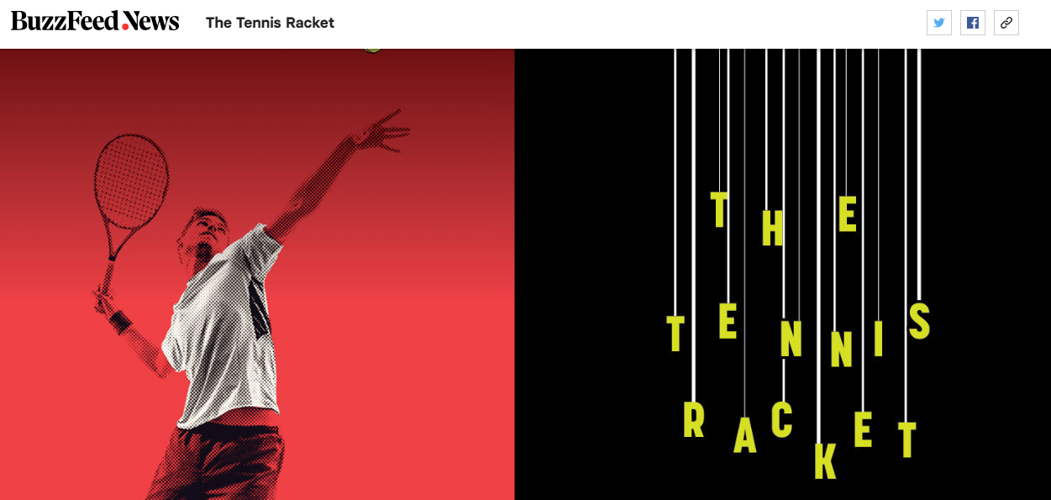
Jupyter Notebooks
https://www.buzzfeednews.com/article/heidiblake/the-tennis-racket
https://github.com/BuzzFeedNews/2016-01-tennis-betting-analysis
Notes:
https://mybinder.org/

Slide 66
Summary

Slide 67
Reflections
Dynamic documents are a tool not a panacea.
The researcher needs to change the way they work:
I feel that undertaking research within a dynamic document encourages me to work in a more ‘literate’ manner.

Slide 68
Reflections
We need to think about how these tools work with social science data that cannot be shared openly.
Could we link Jupyter Notebooks up directly with the Data Archives (with researcher log-in required)?
How should we work with secure data (e.g. administrative data)?
We need to continue to think about what should be included in a dynamic document (so it can constitute a research object):
Do we need discipline specific guidelines and templates?

Slide 69

Open Social Science
The Unknown
Notes:
An innovative aspect of this work is that we go beyond providing the usual supplementary material and make the complete workflow openly available. We take the trailblazing step of rendering the complete workflow accessible and reproducible within a Jupyter notebook5 (Kluyver et al. 2016). Jupyter notebooks are an open source web-based application that enable researchers to author documents that include live code6 (e.g., Stata or R code), alongside data analysis outputs (e.g., modelling results, plots etc.), and documentation (e.g., narrative text describing and detailing the workflow). Jupyter notebooks have been used in Nobel Prize winning high-profile big science applications7 but are rarely used in Sociology.
In developing an open and published workflow we have drawn upon ideas advanced in computer science especially the concept ‘literate computing’, which is the weaving of a narrative directly into live computation, interleaving text with code and results in order to construct a complete piece that achieves the goals of communicating results10 (Knuth 1992).

Slide 70
Roxanne Connelly
roxanne.connelly@york.ac.uk
@ConnellyRoxanne
These materials draw heavily on collaborative work developed with Professor Vernon Gayle, University of Edinburgh. His contribution is gratefully acknowledged.

